Slide 1
FAKE NEWS
BULGARIAN CASE
BY: IVAN TINCHEV

Slide 2
“Bulgarians do not need a state’’
In February 2017, various websites reported that Johannes Hahn, European Commissioner for European neighborhood policy and enlargement negotiations, had secretly suggested that Bulgaria would disappear as a nation in 40 years and that the EU should claim its territory.

Slide 3
“Bulgarians do not need a state’’
The story was, in fact, first published in April 2013 by a satirical portal whose authors clearly indicate in their website that everything they publish is a product of their imagination.

Slide 4
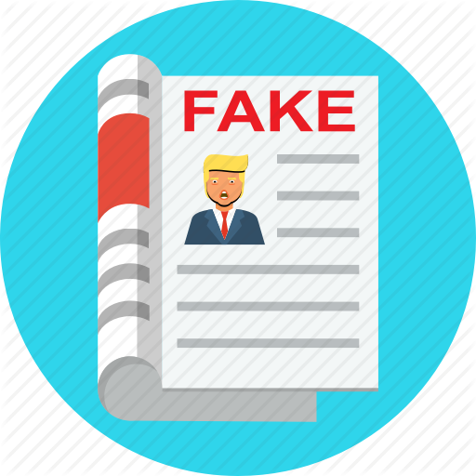
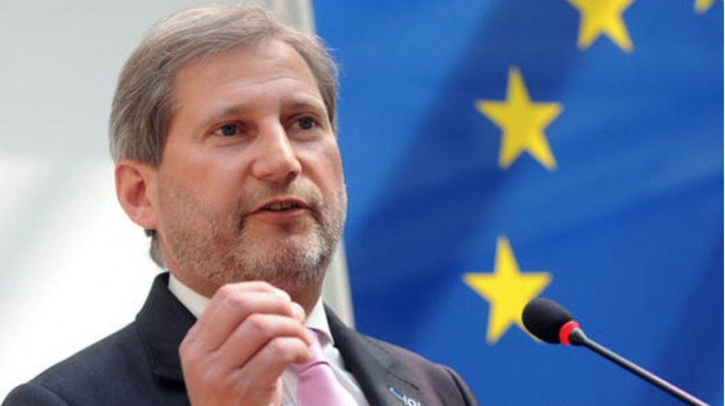
.
After that, the European Commission found itself pressed to explain that Commissioner Hahn had never said that Bulgarians would disappear and that their land would be settled by foreigners.
“On the contrary, it should be noted that, within the framework of his mandate as Regional Policy Commissioner of the EU from 2010 until 2014, he contributed to reforms in the country with the purpose of ensuring its sustainable modernization.”
.

Slide 5
HOW DID I
SPOT IT?
Firstly, I took a closer look by checking the source of the story. I was unfamiliar with the site, so I looked the about section up and found out more information about the author.
Timing is also important. Fake news stories often contain incorrect dates, so I checked when the article was published, whether it is a current or an old news story.

Slide 6
Some fact-checking websites
I also used fact-checking websites (International Fact-Checking Network (IFCN), politifact.com or snopes.com). They all check whether a story is real or fake. Also, these sites often do extra research so I can find out the whole story.

Slide 7
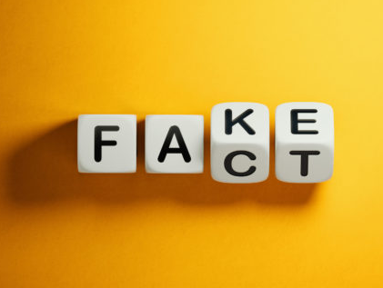
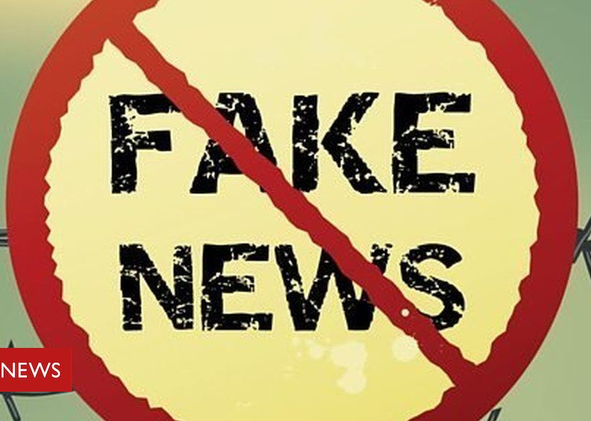
Danger and consequences of fake news
Fake news can be very dangerous today. They seriously threaten to undermine discussions on topics of public interest. They manipulate people’s perceptions of reality, mostly used to influence politics and promote advertising. Fake news can even cause violence, fear or ruining one’s reputation.

Slide 8
Thank you for your attention!

