Slide 1
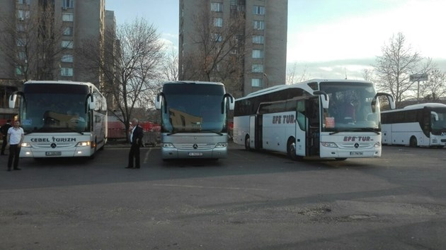
Fake news bulgaria
“Turkish Tourists who regularly arrive in Kurdzhali are in fact immigrants, not tourists”

Slide 2
Last week ten buses entered Bulgaria from “Captain Andreevo”
The article says :
The buses travel mostly to the region of Haskovo and Kurdzhali.
Only within one hour four suspicious buses arrived at the bus station in Kurdzhali.
The buses don’t belong to any tourist agency .
No routes are mentioned on their windshields notices
As a conclusion, the article says they could actually be full immigrants, who want to move to Europe.

Slide 3
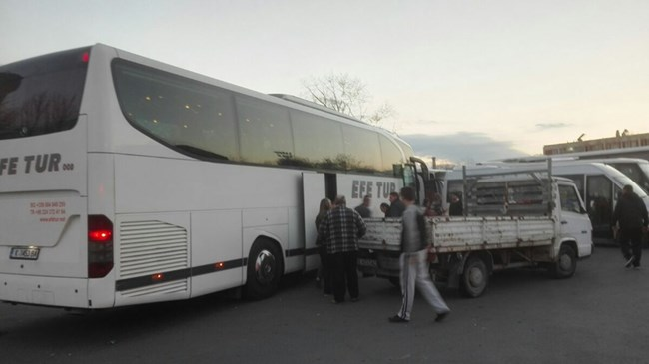
Fake article
I find the article fake because the site is anonimous and the author of the article is also unknown.
There are no eyewitnesses mentioned/registered.
There are a lot of spelling mistakes, which speaks volumes about what kind of people deal with such stuff.
And the information isn’t full.

Slide 4
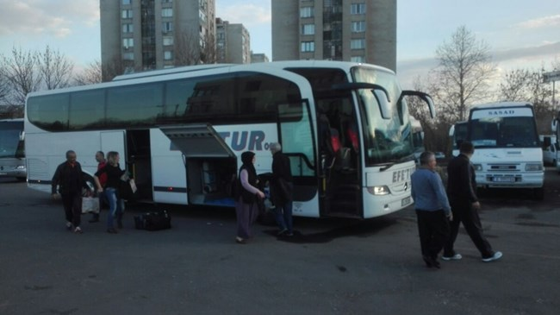
The consequenses
That fake news can damage the relationship between Turkey and Bulgaria.
This can lead to closed boarders.
mightnot allow Turkish tourists to cross the border for a certain period of time.
The news may damage the Kurdzhali region’ reputation badly.

Slide 5
Thank you for the attention

