Slide 1
Fake news
RAZLOG STOPS THE WATER IN BANSKO!

Slide 2
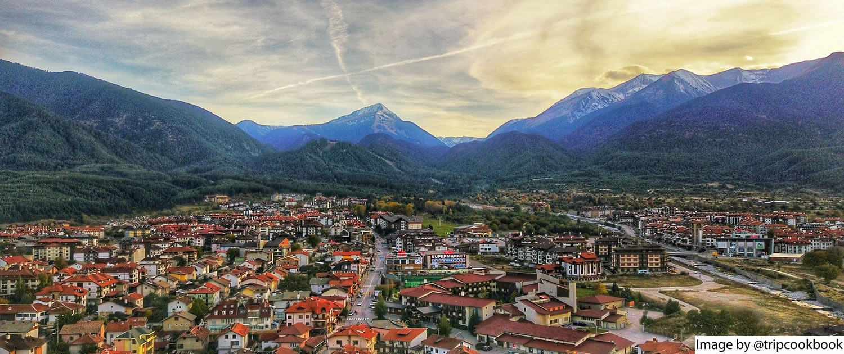
BANSKO
As you already know we are from Razlog , Bansko is a town near to Razlog , and is a much bigger tourist destination – mainly a ski resort!

Slide 3
THE NEWS
There were posts from many sites in the social media one day stating Razlog had stopped the water for Bansko… Which was totally untrue and we are going to explain it in a second!

Slide 4
We had read about it but it was hardly believable that our mayor and his team had done something like that so last week when the mayor came to visit us in school we had to ask him to get to know what truly happened!

Slide 5
His explanation was much more believable , the thing that had happened was – Razlog had stopped the water cisterns from the village Banya (near Razlog) leaving to other villages and towns in our municipality!

Slide 6
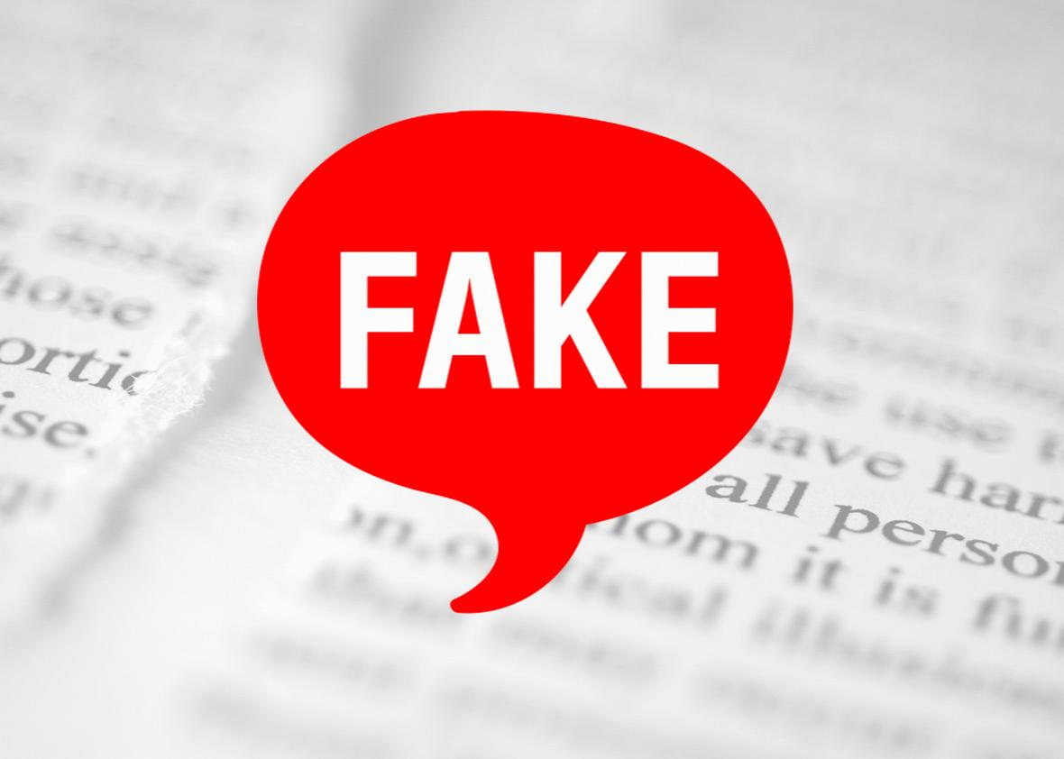
No one had stopped the water in Bansko and no one had cut their pipes and water sources , it had as its aim to probably lower the tourism in Bansko or it had just been another clickbait site witch earns money by – u clicking on it!

Slide 7
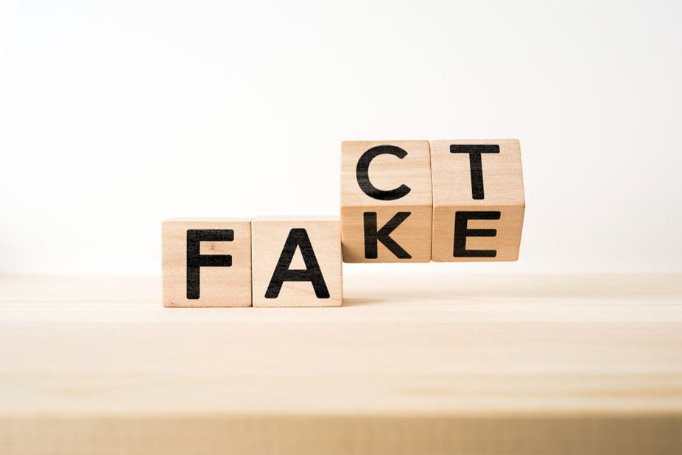
That’s what usually fake news do – they aim to get your attention because they either get money by the traffic of views on the site or they aim to just darken someone’s reputation!

Slide 8
Avoiding fake news and checking if they are real can be quite easy – You just check the official site of the thing you’ve read about or search for more than ½ posts about it that aren’t the same !

Slide 9
THANK YOU FOR YOUR ATTENTION

